Slide 1
A&R BRIEF
WHAT I’M
TAPPED INTO
RIGHT NOW
Three artists I’m already connected to—and why I’d bring each one into the room
Robert Spann • Atlanta • August 2026
MIDNIGHT JET
PISTOL PO
WILLDABEAR
Notes:
[Sources]
Private applicant-created hiring sample. No QC logo or official-affiliation claim.
Opening line: I wanted to keep this short and show you three artists I’m already close enough to reach and bring into a real conversation.
Operator-supplied relationship fact: Robert has a connection to all three artists and can reach out to each one. The deck does not claim management, representation, endorsement or equal relationship depth.

Slide 2
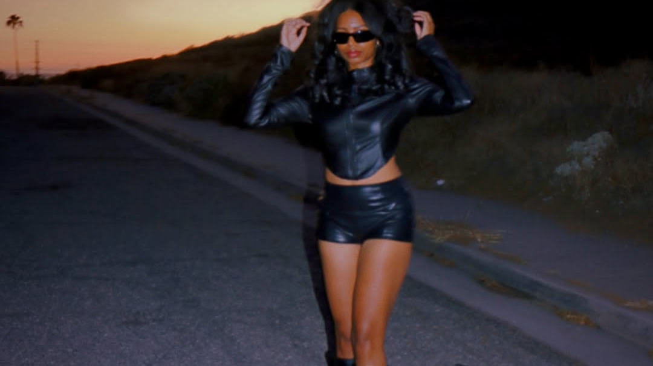
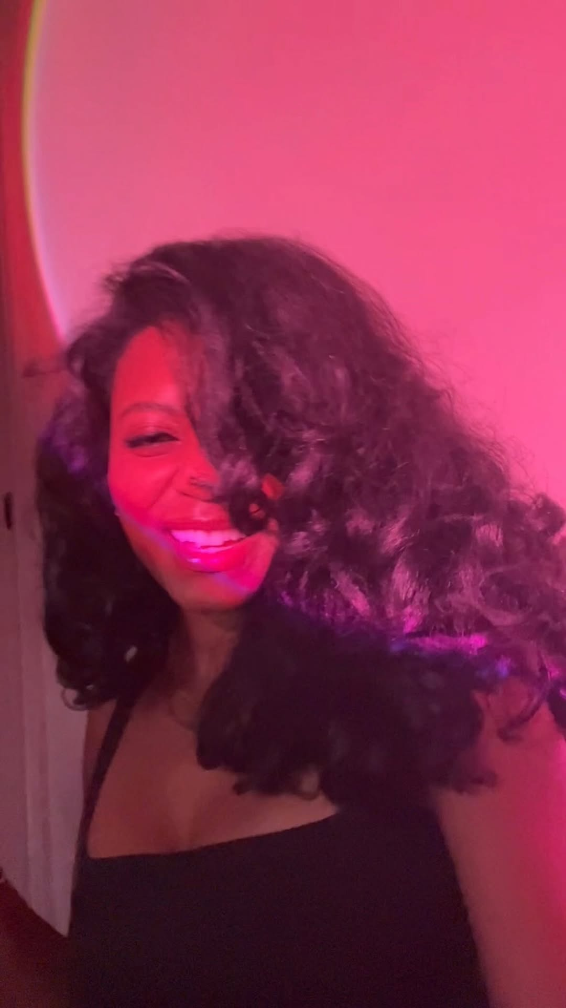
MIDNIGHT JET
You can recognize
Midnight Jet before
you read the name.
Her visuals live in dusk light, moving between open roads and low-lit rooms with the same soft-focus look. The first thing to do here is press play.
Current public visual • Instagram Reel
▶
Play Midnight Jet
Watch one more current reel
Opens Instagram if playback is unavailable
Notes:
[Sources]
Hero: https://www.instagram.com/p/DbeABCHDzi6/
Embedded reel: https://www.instagram.com/reel/Dawk2f0Jmtm/
Secondary reel: https://www.instagram.com/reel/DaLfJdipbXp/
Supporting public-reel engagement at capture: 2,259 likes / 250 comments; 2,032 likes / 336 comments.
Visual consistency is not presented as proof of audience demand or label readiness.

Slide 3
Midnight Jet is growing without leaning on one song.
Her Spotify audience grew sharply from January to August without visible editorial support. I’d bring her in, hear more music and understand the team, rights and release plan.
January 1 → August 18, 2026
Spotify followers
Latest 28 days
271 → 1,302
+276 followers
+3,243 monthly listeners
+380%
Monthly listeners
2,058 → 6,886
4 tracked songs
175,241 combined
+235%
Top tracked song • 97,292
5,600 Shazams
31 Spotify playlists • approximately 719 reach • 0 visible Spotify editorial
The next step is to bring her in and listen.
Listen: “I’m Still Missing You”
Notes:
[Sources]
Spotify followers: 271 on Jan. 1, 2026; 1,302 on Aug. 18, 2026.
Monthly listeners: 2,058 on Jan. 1; 6,886 on Aug. 18.
Latest accepted 28 days: +276 followers; +3,243 monthly listeners.
Four tracked songs total 175,241. Top tracked song: 97,292 with 5,600 Shazams.
Playlist reach is approximate. Zero visible Spotify editorial applies only to the accepted capture.
Catalog listen cue: https://open.spotify.com/track/1I5xO6Oy6hGdlbuDPLJZDR
The song cue is a direct public catalog link. It is not presented as the audio used in the reel and does not autoplay.
At capture, two current public reels showed 2,259 likes / 250 comments and 2,032 likes / 336 comments. These are concurrent social signals, not proof that one platform caused the catalog movement.
Who controls the masters and publishing, who is on the current team, which records are finished and release-ready, and what she can deliver live and in the studio are meeting questions—not facts supplied by public sources.
This supports a meeting, not a signing declaration.

Slide 4
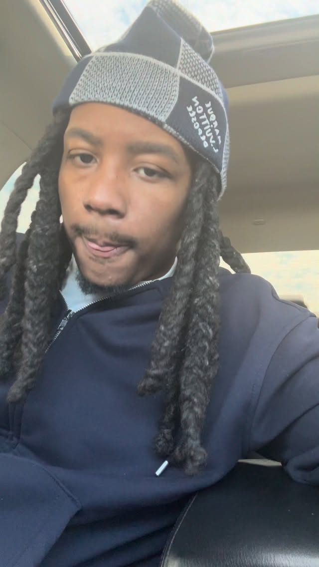
PISTOL PO
PUBLIC REACTION
Six verified reactions from the public sample
The freestyle
changed the size
of the conversation.
1,000 comments sampled · 84 unique verified accounts
One row = one comment. Blue text = people who liked that comment.
@rob49up
“Yu goin to hell 4 dat!!”
9,800 people liked this comment
@42_dugggg
One comment · seven fire emojis
The video stays locked on him in the car and lets the verse do the work. It posted February 27 and drew 217,742 likes and 9,578 comments at capture.
2,377 people liked this comment
@bendadonnn
“Talkinnnnn 😮‍💨🔥🔥🔥”
2,145 people liked this comment
POSTED FEBRUARY 27, 2026
@dcyoungfly
One comment · three fire emojis
1,418 people liked this comment
217,742
@famousdex
“On folks 🔥”
LIKES
1,094 people liked this comment
9,578
@lakeyah
One comment · one fire emoji
COMMENTS
269 people liked this comment
Play the freestyle
The clip came first. The months of growth after it are why I would take the meeting.
▶
Public recognition—not an endorsement, QC approval or signing signal.
Opens Instagram if playback is unavailable
Notes:
[Sources]
Verified reel: https://www.instagram.com/reel/DVRI-8dDSKA/
Posted Feb. 27, 2026. Visible engagement at capture: 217,742 likes; 9,578 comments.
The recognition rail comes from a bounded public-source capture of 1,000 of the 9,578 visible comments. That sample contained 93 verified comment records from 84 unique verified accounts. Each displayed account was separately checked against a public Instagram profile showing the verified badge.
Each visible row is one comment. The displayed count is the number of people who liked that comment, not the reel's like count and not a count of posts.
@rob49up: 'Yu goin to hell 4 dat!!' — 9,800 comment likes. @42_dugggg: seven fire emojis in one comment — 2,377. @bendadonnn: 'Talkinnnnn' plus reaction/fire emojis — 2,145. @dcyoungfly: three fire emojis in one comment — 1,418. @famousdex: 'On folks' plus a fire emoji — 1,094. @lakeyah: one fire emoji — 269.
Quality Control's official artist site identifies Lakeyah as a QC artist, but her individual comment is shown only as a public reaction—not as a statement from QC.
Public reactions are not endorsements, deal interest, QC approval or evidence of signing intent. Lil Baby was not verified in the bounded sample and is not claimed.
Public view count unavailable. Exact TikTok post/sound source unresolved.
The reel preceded later growth; the deck does not claim it single-handedly caused that growth.

Slide 5

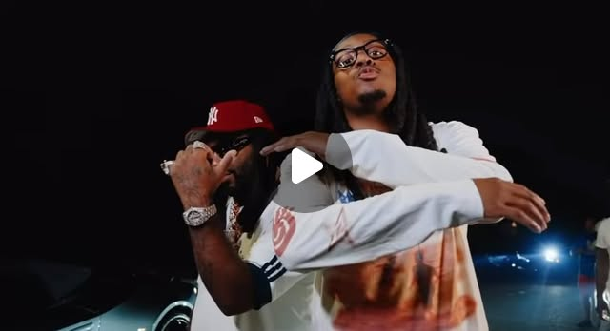
The audience kept growing after the freestyle.
The first public Spotify baseline came 17 days later, and his audience was still climbing in August. The Icewear Vezzo feature adds context, but I would not count that record as proof of his solo audience.
MARCH 16
78 Spotify followers / 270 monthly listeners
JULY 17
Icewear Vezzo — “Going On (feat. Pistol Po)” released
JULY 30
“Going On” Collab reel
12.6K likes / 878 comments at capture
Open the “Going On” Collab reel
AUGUST 18
796 Spotify followers
14,453 monthly listeners
Latest 28 days: +166 followers / +5,482 monthly listeners
51 Spotify playlists / approximately 49,906 reach / 0 visible Spotify editorial
4 Apple Music editorial placements
In the room, I’d ask to see the original TikTok source, look at saves and repeat listening, hear the strongest solo record, and understand the team, rights and next release.
Notes:
[Sources]
Portrait source: https://www.instagram.com/p/DbjNK_bAYHp/
First available Spotify baseline, March 16: 78 followers; 270 monthly listeners.
Aug. 18: 796 followers; 14,453 monthly listeners. Aug. 19 snapshot: 811; 14,483.
Latest 28 days: +166 followers; +5,482 monthly listeners.
Cross-platform spread has some supporting evidence, but the original TikTok post/sound remains open.
Apple Music feature record: https://music.apple.com/us/song/going-on-feat-pistol-po/6780209897
Apple Music lists Icewear Vezzo as the primary artist and Pistol Po as the featured artist on ‘Going On (feat. Pistol Po)’ from Rich Off Pints 4. Release date: July 17, 2026, 140 days after the freestyle reel.
Verified July 30 Collab reel: https://www.instagram.com/reel/DbbKlkxRMFF/
Icewear Vezzo and Pistol Po published the Collab reel July 30. The caption names ‘Going On,’ tags @pistolpo79, and the reel showed 12.6K likes / 878 comments at capture.
This is verified chronology and collaboration context only. The deck does not say the February reel caused the feature, that the collaboration represents signing interest, or that activity attached to Icewear Vezzo's record proves Pistol Po's solo audience.
Meeting questions: original TikTok source and clean source history; saves, shares, profile visits, follower conversion, repeat views and repeat listening; strongest solo record; current masters and publishing; team, next release, and live/studio readiness.
The Collab poster and track title are external links only. They do not autoplay and do not create a fourth embedded playable moment.

Slide 6
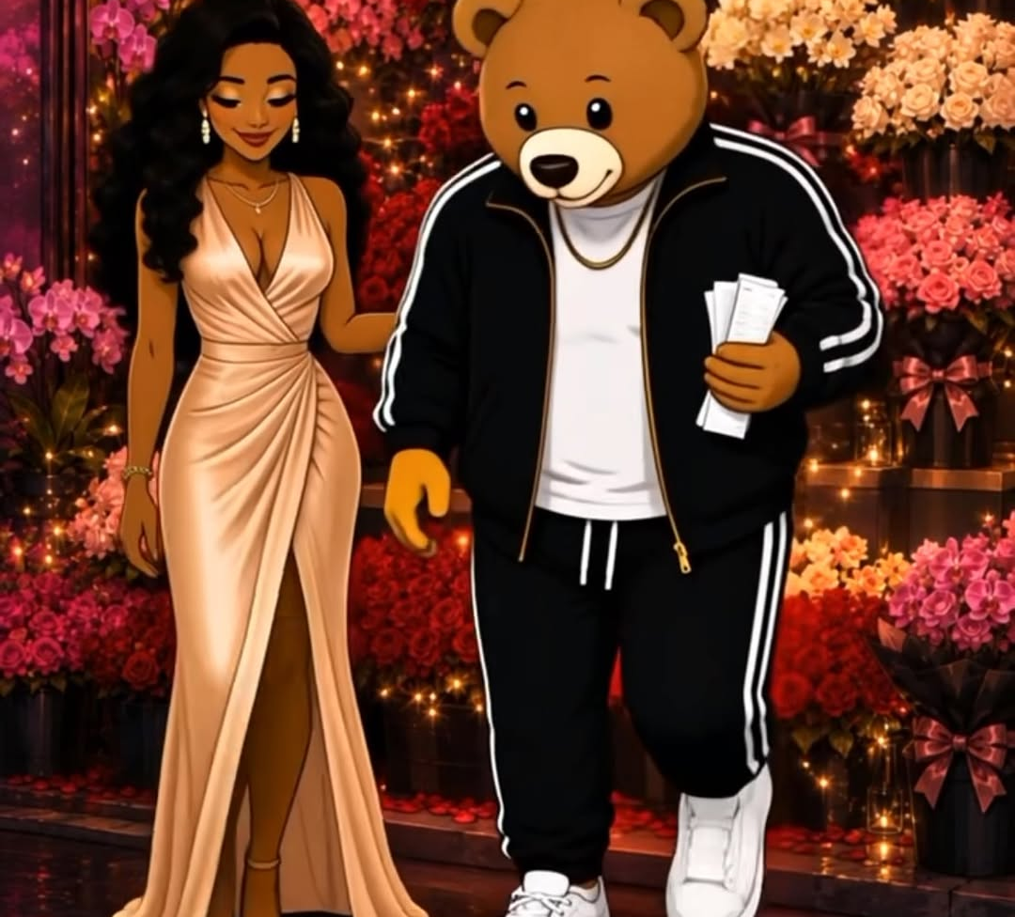
WILLDABEAR
WillDaBear has a real writing credit. The artist side is still early.
William Hood is a credited composer/lyricist on Ciara featuring Chris Brown’s “How We Roll.” The official video had 82.1M+ views on August 20, but that scale belongs to the released work—not to WillDaBear’s own artist demand.
Early artist profile
9 Spotify followers / 1 monthly listener / popularity 0
3 Shazams / approximately 2.9K Instagram
Open the WillDaBear cartoon
“HOW WE ROLL”
William Hood / IPI 00426248560
Composer / lyricist
ISRC QZS7J2311667
ISWC T3214637813
82.1M+ official-video views
August 20, 2026
Notes:
[Sources]
Verified credit identity: William Hood, IPI 00426248560, composer/lyricist on Ciara featuring Chris Brown's How We Roll.
ISRC QZS7J2311667; ISWC T3214637813.
Official video snapshot: 82.1M+ views on Aug. 20, 2026. This is released-work scale, not WillDaBear artist demand or sole-writer attribution.
Cartoon reel: https://www.instagram.com/reel/DaQ5IA-SdjZ/
Early artist profile shown without inflation.

Slide 7
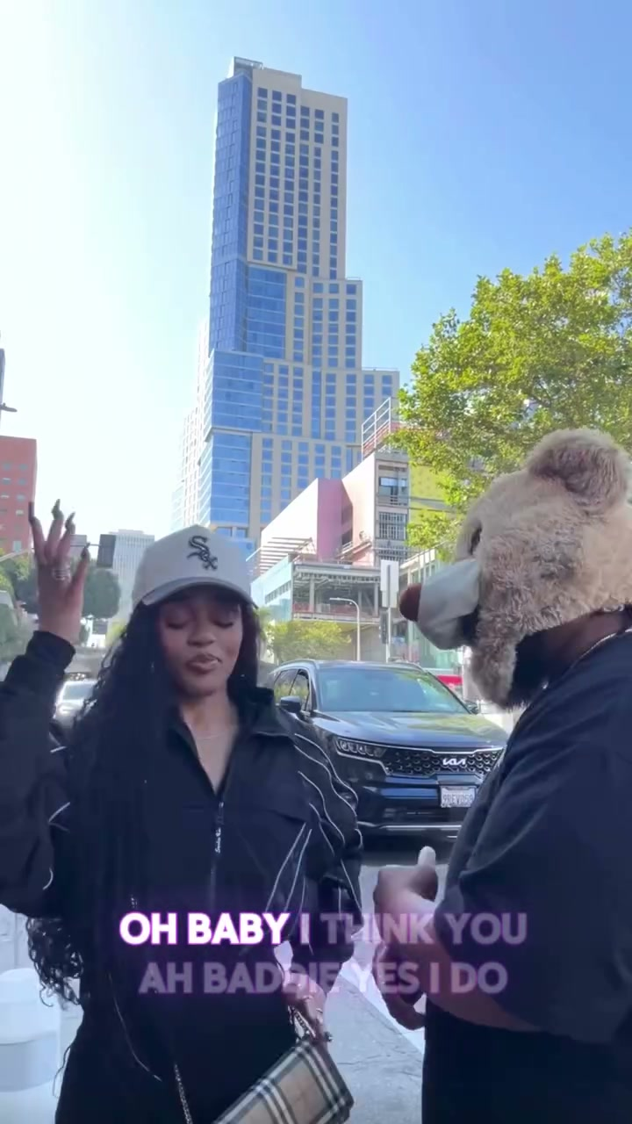
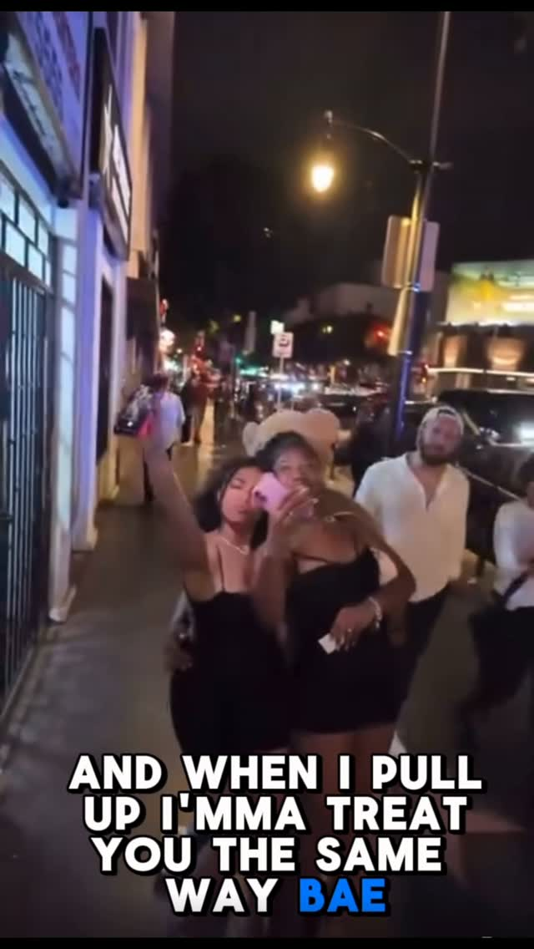
WILLDABEAR · “BADDIE” PRE-RELEASE
Women with real audiences are already tapping into “Baddie” before release.
Sherrion joined the Collab post. Karlae shared another “Baddie” reel to her Story and wants to make more content. The useful signal is the pattern: women with real audiences want to participate before the single is out.
SHERRION
Collab post · 312 likes / 46 comments
37.7K Instagram followers at capture
KARLAE · @okaykarlae
1M+ followers · 10.4K plays on this WillDaBear reel
Shared it to her Story and wants to make more content
SHERRION COLLAB
KARLAE STORY-SHARED REEL
312 likes · 46 comments
1M+ followers · 10.4K plays
Early creator pull—not proof of audience conversion yet.
▶
Play Sherrion Collab
▶
Play Karlae reel
Instagram fallback
Instagram fallback
Notes:
[Sources]
Verified Collab: https://www.instagram.com/reel/DZajbjGSScZ/
Public Collab identifies @willdabearmusic and @sherrionn. Posted June 10, 2026.
Visible engagement at capture: 312 likes; 46 comments. Sherrion: 37.7K visible followers at capture.
Verified WillDaBear reel: https://www.instagram.com/reel/DaL2GUWS0UL/
The public reel belongs to @willdabearmusic, code DaL2GUWS0UL, and showed 10,429 plays at capture. Karlae's public profile is @okaykarlae, display name Jerrika Karlae, verified, with 1,086,547 followers at capture.
Operator-supplied relationship evidence: Karlae shared the supplied reel to her Story and wants to make more Baddie content. No persistent public Story capture is claimed.
The visible copy intentionally keeps WillDaBear and Baddie as the subject. Sherrion and Karlae are two examples of pre-release creator pull.
Do not imply a contracted campaign, guaranteed posts/reach, paid partnership, endorsement, conversion forecast or signing interest.
Baddie is not described as viral, radio-supported or proven at scale.

Slide 8
I lead with the music.
The tools help me follow through.
Two song-registration apps
Release data, credits, splits, identifiers and assets
I start with the song and the artist. These aren’t cold finds—I’m connected to all three and can reach each one. The tools help me keep the facts straight and stay organized after the meeting.
A private label-operations system
Catalog, releases, publishing, agreements, money, tasks and evidence
A weekly artist analytics tracker
Instagram, Spotify for Artists and Apple Music for Artists in one place
I’d welcome the chance to talk through what I’m tapped into and what I’ve been building.
Notes:
[Sources]
The tools listed here were built by the applicant.
The access statement is operator-supplied: Robert can reach all three artists. No management, representation, endorsement or equal-relationship claim is made.
They organize release, registration, catalog and analytics information.
They are not claimed to discover artists automatically, predict hits, monitor trends automatically, replace relationships or produce signing outcomes.
End after the closing line. No separate thank-you slide.

